Slide 1
Documentary Study
Year 12 English
General Course

Slide 2
Lesson 1
Learning Intentions
To explore the topic: “Health”
To revisit the nature of a documentary
Success Criteria
Completed pre-viewing questions

Slide 3
Lesson 1 Activities
Pair Work
Discuss Questions 1-3 in the handout
Respond to the questions in writing
Individual work
Brainstorm the concept of Sugar
Class work
Attend to the information on documentaries
Respond to questions 5-7 in the handout.

Slide 4
Documentary
Conventions
Year 12 English
General Course

Slide 5

Symbolic
Symbols are used to imply meaning that can subtly reinforce the filmmaker’s ideas. Examples of symbolic codes include:
setting
objects
lighting
colours
signs.

Slide 6

Written
The most common uses of written codes in documentaries are:
captions which indicate place, time, names, titles and roles
highlighted or enlarged passages from texts which are used as evidence
key words or sentences displayed on the screen by the filmmaker to reinforce a point or idea.

Slide 7
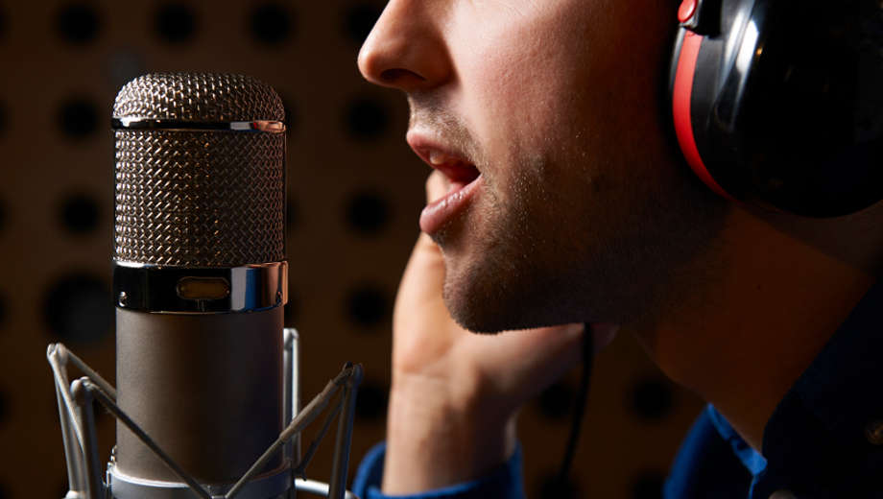
Audio
Many different types of audio are used in documentaries including:
voice-overs
interviews
music for mood or to heighten emotions
ambient sounds.

Slide 8
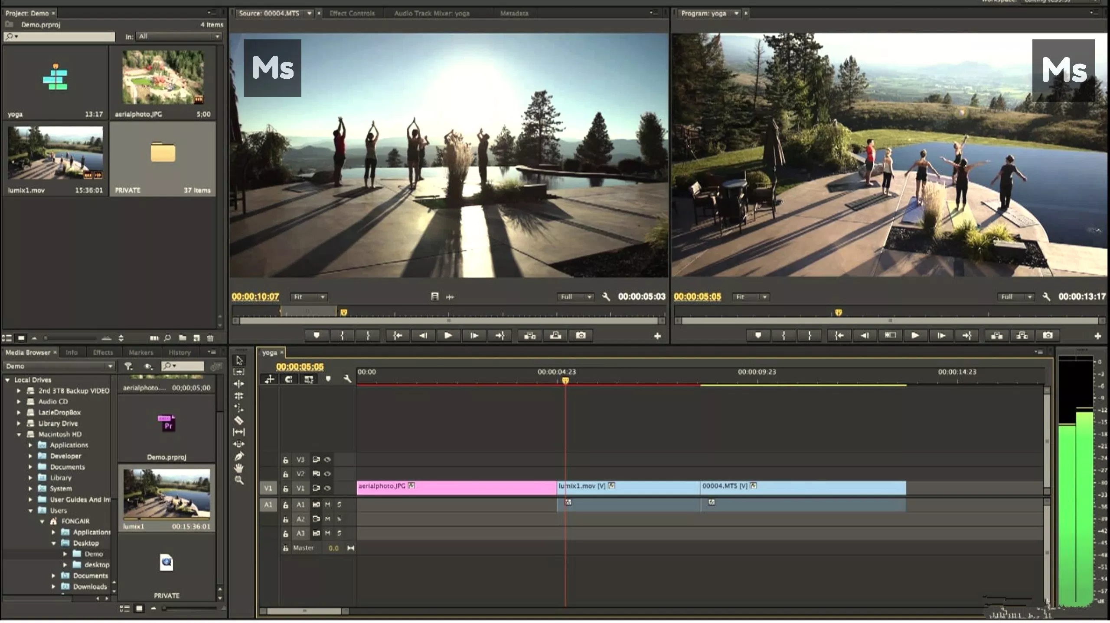

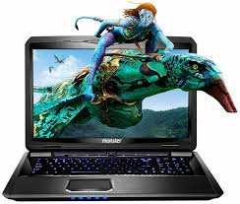

Technical
Probably the most important technical code used in a documentary is editing because it:
structures the information and images, thereby dictating the order in which we receive information
selects details that are considered relevant by the filmmaker and excludes details that are not considered relevant or which may undermine the filmmaker’s ideas
may juxtapose images and information in a way that creates a new meaning.

Slide 9
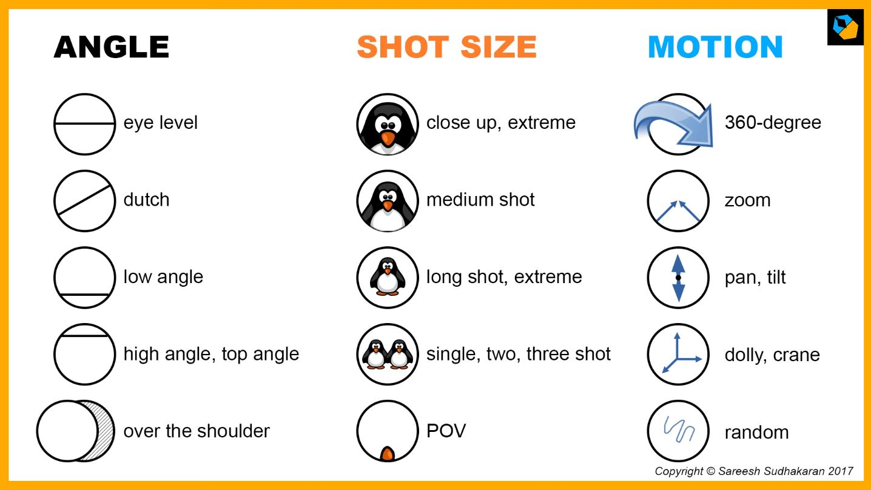
Other technical codes
Camera movement (tilting, tracking, panning and hand-held use)
Camera distance and angle (long shot, mid shot, close-up, high angle, eye-level and low angle)
Lighting.

Slide 10

Interviews
Most documentaries will include interviews.
Interview subjects are frequently ‘experts’ who are included to validate the filmmaker’s ideas. Alternatively they may be everyday people the viewer can relate to and who add a ‘personal touch’.
Interviewees are often responding to set questions; the interviewer or the questions may be excluded from the film so as to give the impression that the interviewee is openly sharing their ideas or recounting their knowledge of the topic.

Slide 11
Authoritative sources
Referring to or using authoritative sources adds credibility to the documentary.
Authoritative sources can take many forms including
studies,
Surveys and statistics,
well-known texts and important documents,
quotes or interviews with experts.

Slide 12
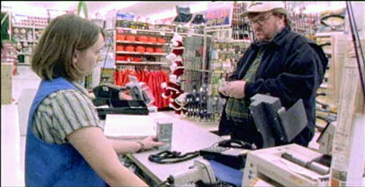
Actuality footage
This is footage taken by the filmmaker in making the documentary.
It is the most common type of footage used, especially in social commentary documentaries.
Actuality footage gives the impression of reality but viewers must remember that the filmmaker still made decisions about what to shoot, when to shoot it and how to shoot it; therefore it’s a version of reality.

Slide 13
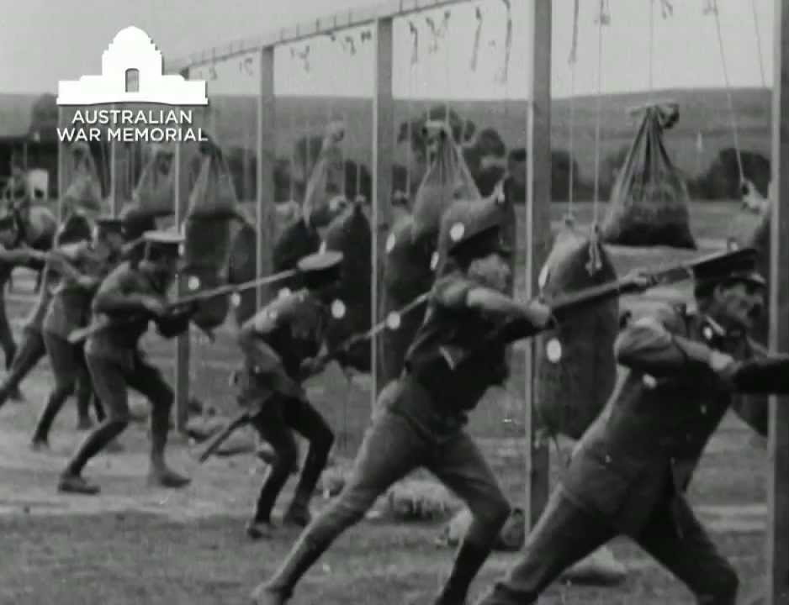
File footage
This type of footage is popular in historical documentaries or to show a subject progression.
It is footage taken prior to the documentary and from other sources.
File footage may be from various sources including television news, archives, other documentaries or past interviews.
It allows filmmakers to provide background to the subject or to show ‘evidence’.

Slide 14

Voice-over
Many documentaries use a voice-over with a narrator talking over the footage.
The narrator may be a fictional character, a hired actor or even the filmmaker themselves.
Voice-over helps explain what we are viewing and adds extra meaning.
Voice-over is also a structural device incorporating verbal transitions to signal a new topic or idea.

Slide 15
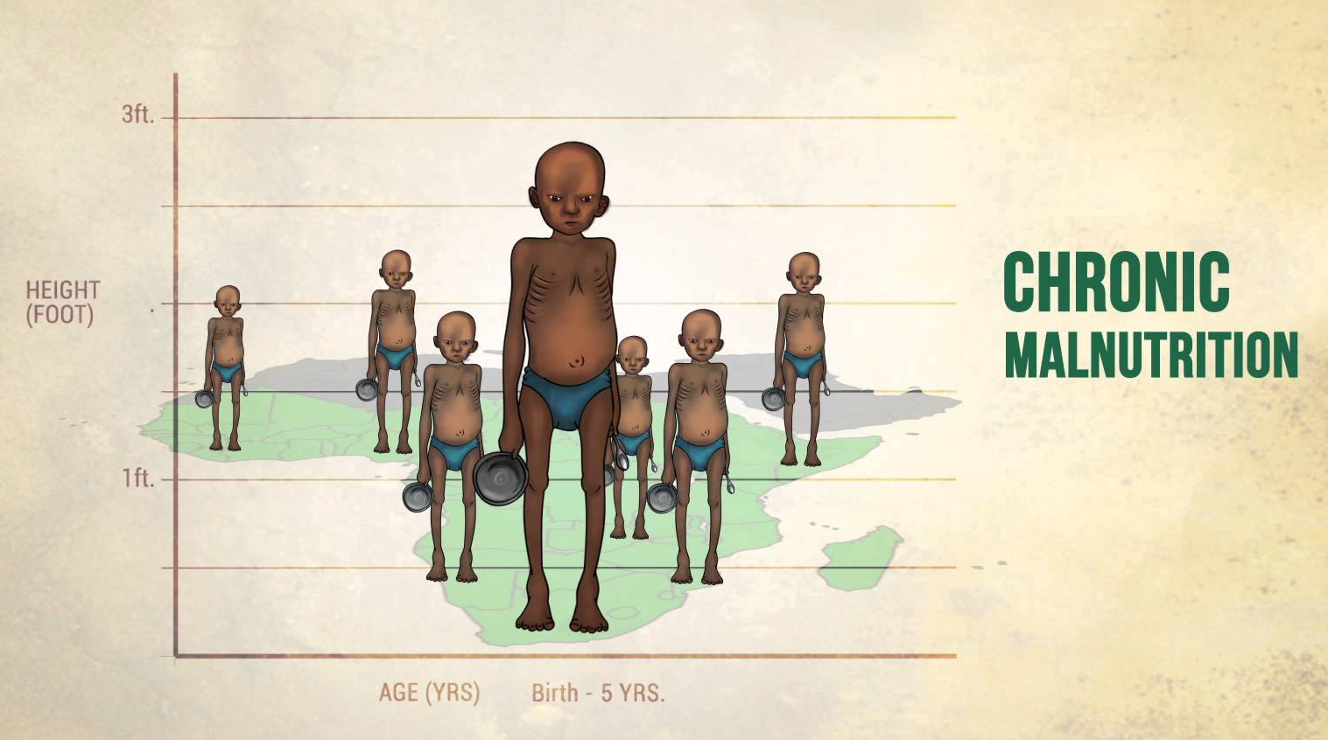
Graphics and animation
Graphics are a visual way of presenting information so it can be quickly understood.
Graphics filmmakers use include graphs, maps, lists and animations.
In recent years filmmakers have also been making greater use of digital animation. This may be to provide for an increasingly technology-savvy audience accustomed to receiving information via multimodal texts.

Slide 16
Lesson 2
Learning Intentions
To view the movie “That Sugar Film”
To examine the opening sequence
Success Criteria
Completed viewing of the movie.
Responded to questions on the opening sequence

Slide 17
Lesson 2 Activities
View opening sequence
Respond to questions 8 and 9 in the handout.
The movie will be stopped at 10 minute intervals to allow you to enter information on Codes and Conventions (Question 10)

Slide 18
Questions
Question 8
What do you think of this opening sequence?
What kind of effect does it have on you, and how is what you’re seeing and hearing affecting how you’re feeling as the film begins?
Question 9
Although Gameau is very natural, charming and open on screen, he is still an actor playing a role he has written for himself.
What kind of self-image has he started to construct here?
Give 3 adjectives you would use to describe him when the film introduces him to us?

Slide 19
Lesson 3
Learning Intentions
To view the movie.
Success Criteria
Completed viewing of the movie
Completed retrieval chart on Codes and Conventions

Slide 20
Lesson 3 Activities
View the movie
The movie will be stopped at 10 minute intervals to allow you to enter information on Codes and Conventions (Question 10)

Slide 21
Lesson 4
Learning Intentions
to view the section on the Experiment
to respond to the Experiment
Success Criteria
Completed response to the Experiment

Slide 22
Lesson 4 Activities
View the section on the Experiment
Discuss the questions with a partner
Present your discussion to the class
Write in your own response

Slide 23
Experiment Questions
Question 11
Why doesn’t Gameau include high-sugar foods like soft drinks and lollies in his experiment? He’s aiming to do more than just tell us that sugar isn’t healthy (we all know that!) – what else is he trying to emphasise?
Question 12
Could you commit to Gameau’s pre-experiment healthy diet yourself? What would be the hardest sugary food for you to give up?

Slide 24
Lesson 5 Activities
Discuss with a partner the purpose of inserting personal scenes in the film
Share your response with the class
Write your written response to Question 13
What is the purpose of scenes like this in the documentary? What are they designed to call attention to?

Slide 25
Lesson 5 Activities
View the “Gross-out” scenes
Discuss in groups of four
The reason for shocking scenes
The value of such scenes
Formulate your own response to Question 14

Slide 26
Mai Wiru sugar challenge questions
Question 15
What is the Mai Wiru sugar challenge?
What happened in Amata before, during and after its introduction and conclusion?
Question 16
What is the impression we are given in this film about Americans and their food and health choices?
Do you think this is an accurate depiction?

Slide 27
Lesson 7
Learning Intentions
To examine the ending sequence to the movie
To respond to the film critically
Success Criteria
Viewed the ending sequence
Justified response to the question.
Reasoned responses to the docco

Slide 28
Lesson 7 Activities
View the closing sequence (last 10 minutes)
Consider the question
Which part of the closing sequence did you like the best and why?
Write a detailed response

Slide 29
Lesson 7 Activities
INDIVIDUAL WORK***INDIVIDUAL WORK*** INDIVIDUAL WORK*** INDIVIDUAL WORK*** INDIVIDUAL WORK**
Question 18.
What did you think of That Sugar Film? Give your opinions on the following, explaining your answers.
What elements of the film did you enjoy or find interesting?
How do you feel about the information presented and the way it is presented?
What things didn’t you like?
Which is the most memorable part of the film for you?
What fact did you find the most intriguing, surprising or shocking?
Who would you recommend this film to?
Why is it worth studying at school?
INDIVIDUAL WORK***INDIVIDUAL WORK*** INDIV
INDIVIDUAL WORK***INDIVIDUAL WORK*** INDIV
INDIVIDUAL WORK***INDIVIDUAL WORK*** INDIVIDUAL WORK*** INDIVIDUAL WORK*** INDIVIDUAL WORK**

Slide 30
Lesson 7 Activities
INDIVIDUAL WORK***INDIVIDUAL WORK*** INDIVIDUAL WORK*** INDIVIDUAL WORK*** INDIVIDUAL WORK**
Question 19.
That Sugar Film is openly geared towards creating dialogue about our health, food choices and changing ideas about ‘healthy eating’.
In your opinion how successful is it in achieving its purpose?
If sugar is so bad for you, why isn’t it banned? Why is it found in or added to so many products?
Create a meal plan for a day that contains no refined sugar.
How hard did you find this to achieve? How about a plan for a week or more? What issues do you encounter? What are the difficulties with choosing a no-refined-sugar diet?
INDIVIDUAL WORK***INDIVIDUAL WORK*** INDIV
INDIVIDUAL WORK***INDIVIDUAL WORK*** INDIV
INDIVIDUAL WORK***INDIVIDUAL WORK*** INDIVIDUAL WORK*** INDIVIDUAL WORK*** INDIVIDUAL WORK**

Slide 31
Lesson 8
Learning Intentions
To consider the impact of the docco.
To prepare for an assessment task
Success Criteria
Completed Impact Chart
Completed mock assessment

Slide 32
Lesson 8 Activities
Gameau says his main motivations for changing his eating habits were personal – first he wanted to impress his girlfriend, and now, as a soon-to-be-father concerned for the health of his child, he’s anxious to find out all he can about the effects of sugar.
What influences your food choices?
How many of these affect your diet?

Slide 33
Lesson 8 Activities
View the trailer twice and then respond to the following questions
What is the genre?
Narrative: how is the story told?
Location: how does the trailer reveal location?
Characters: describe the people portrayed in the trailer
Voice Over: who is the narrator?
Theme: identify at least one theme based on the trailer
Pacing: how is the trailer paced: fast, medium, slow?
On-screen graphics: what kind of info is revealed--be specific
Music and other sound effects: what role do they play?

Slide 34
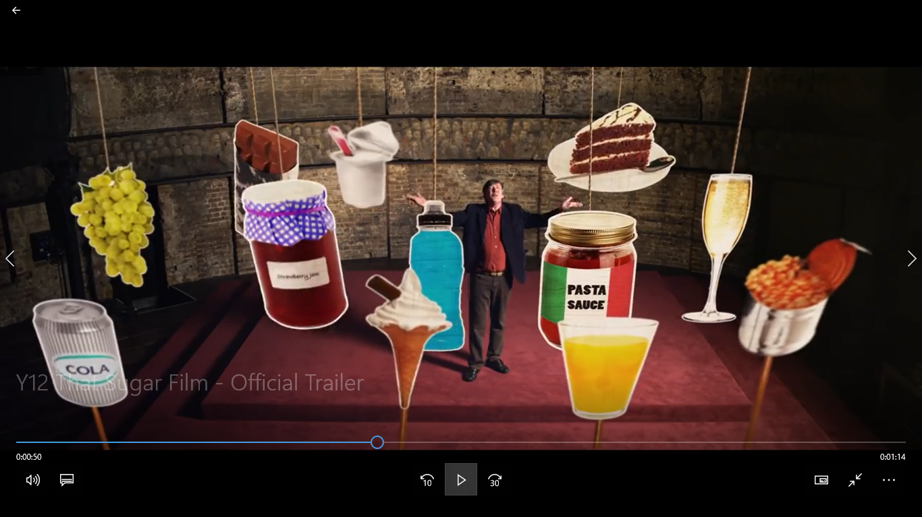
Annotate the following two images, identifying the visual conventions used (camera shots, angles, composition, mise-en-scene, etc). Explain the main ideas in each image.

Slide 35
